Slide 1
CSC 263-001
Pet Sitter Response Tracking System
Team: RAD-LADS
By: Delaney Noel, Dimitri Maragh

Slide 2
Roles
HTML, PHP, ERD Diagram, Back End Design, Create tables - Delaney Noel
Presentation, Test Data, Front End Design- Dimitri Maragh

Slide 3
Case Study
When service is requested, unique identifier (Primary key, probably an int, auto-increment by one). 5 attributes, order number (primary key), type of order, date, service state, and free form comments (list of comments).
Each comment is associated with who wrote it, probably a separate table. Body text of comment, who made it, date, foreign key order number, primary key who made it and date (maybe order number). Comments can be made by any number of people and IP addresses.
Order types will also be split into another table, one with Type of Order ID and an explanation of it.
People all have first name, last name, role, phone, email address. Which are then split into three types.
Clients create and manage requests, also add comments.
Handlers recommend pet sitters to clients (clients can either accept or deny)
Sitter gets access to clients contact info when assigned, then when completed the order is archived.

Slide 4
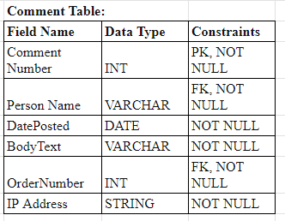
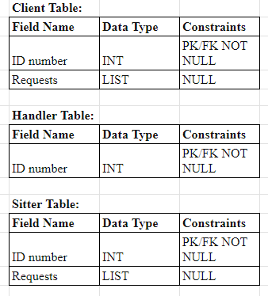
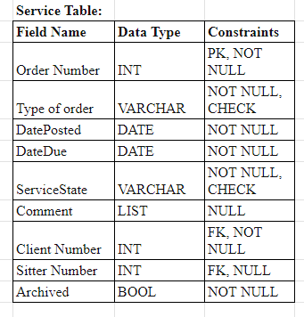
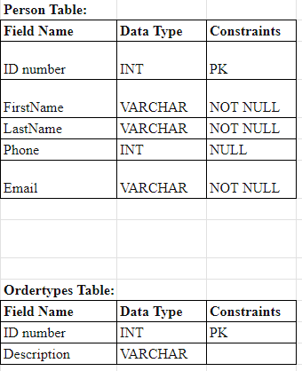
Schema Design

Slide 5
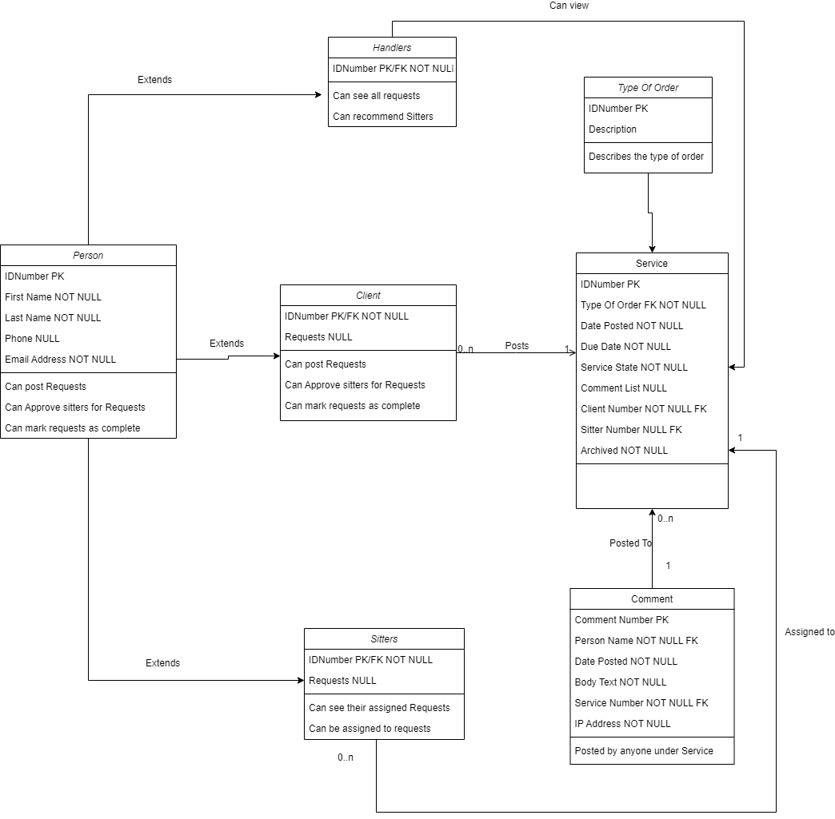
ERD Diagram
We can see that the table is normalized to 3NF as there is no transitive property. For example, if you know the phone number of a person, you don’t know what services they are assigned to. Only primary and foreign keys allow us to connect the tables to one another.

Slide 6
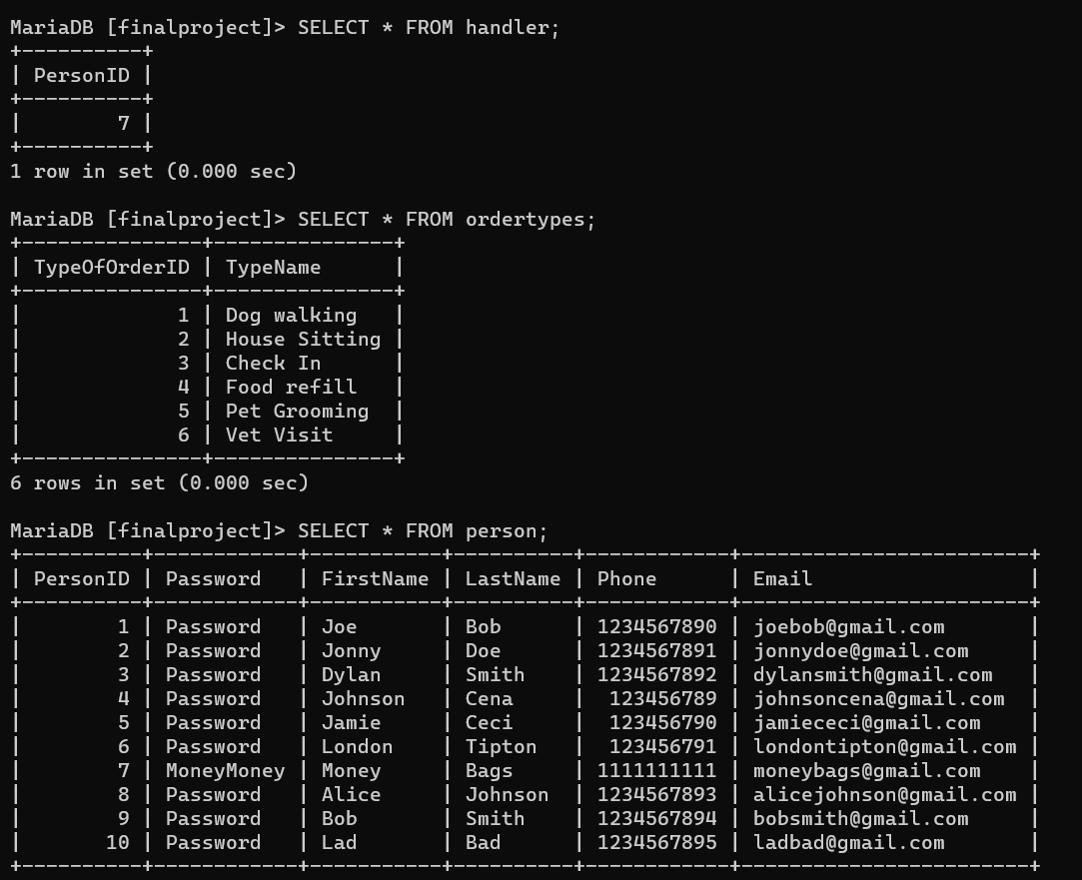
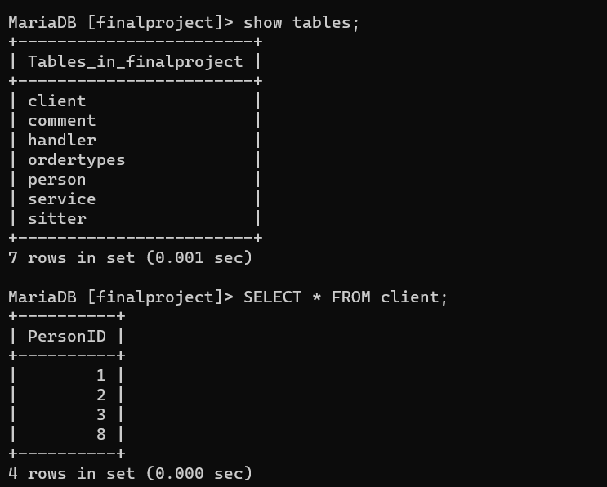
All Tables

Slide 7
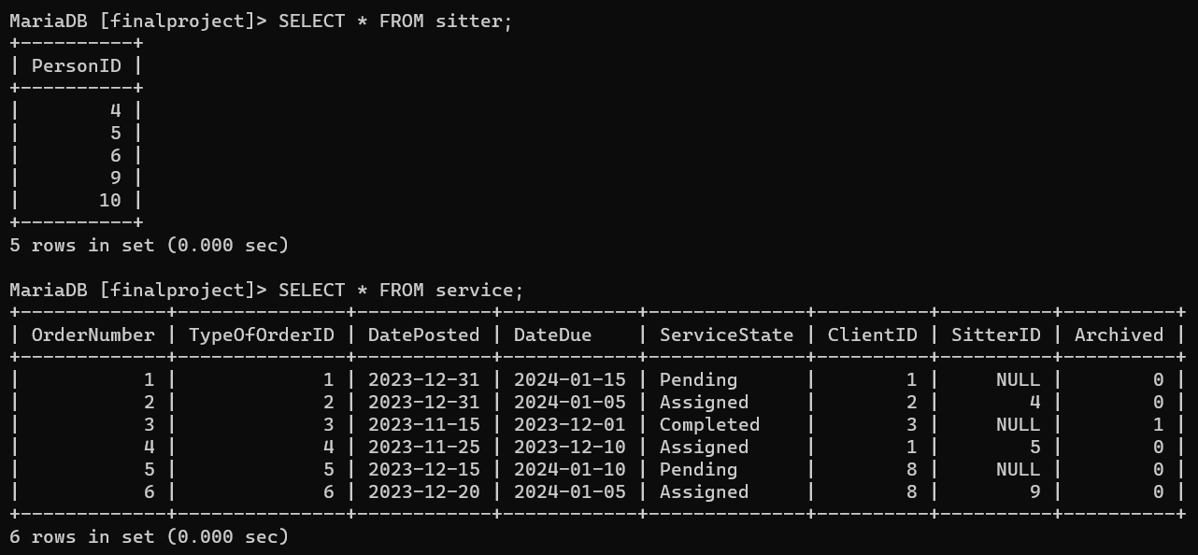
Tables CONT

Slide 8
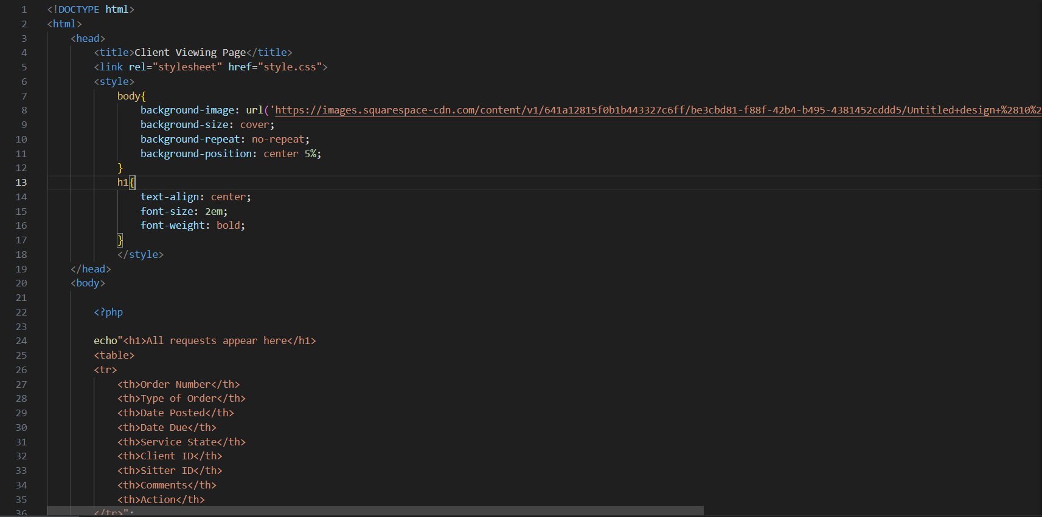
PHP, HTML, SQL Integration
The code integrates PHP, HTML, and SQL statements throughout. For instance, the PHP code is embedded within the HTML body .
<body>
<?php
// PHP code
?>
</body>

Slide 9
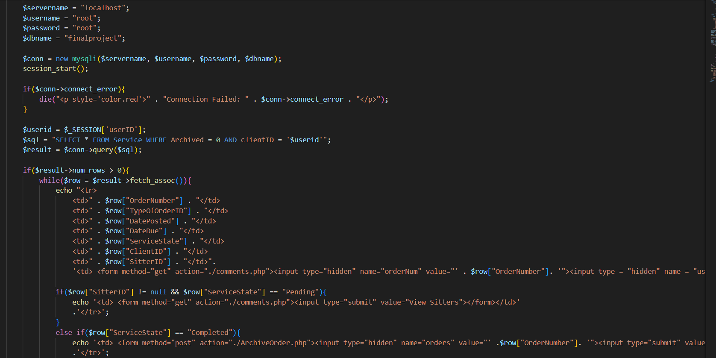
Integration CONT, Server-Side Web-based
Then the SQL statements are used within the PHP code to interact with the database.
$conn = new mysqli($servername,
$username, $password, $dbname);
$sql = "SELECT * FROM Service WHERE Archived = 0 AND clientID = '$userid'";
$result = $conn->query($sql);
The PHP code is used to establish a connection to the server-side database. $servername = "localhost";
$username = "root"; $password = "root"; $dbname = "finalproject"; $conn = new mysqli($servername, $username, $password, $dbname);

Slide 10
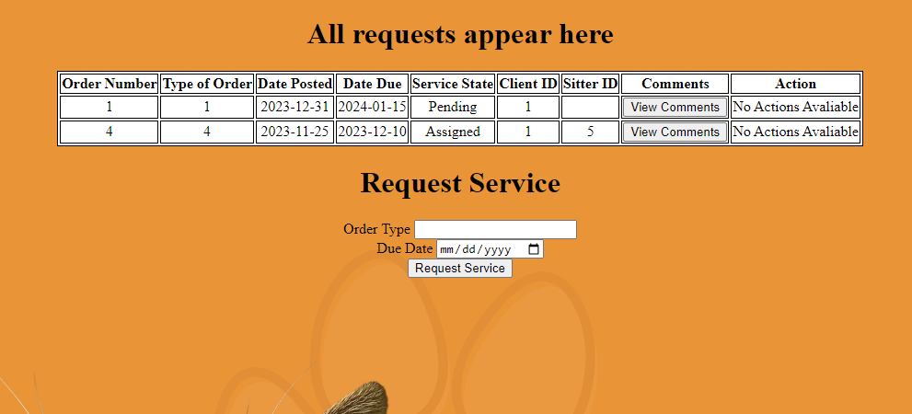
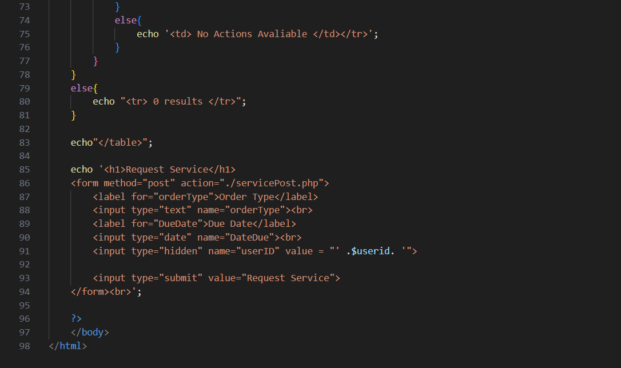
HTML Forms For DATA Input
The code contains an HTML form that collects user input for an Order Type and Due Date. The form uses the POST method to send this data to the servicePost.php page when the Request Service button is clicked.

Slide 11
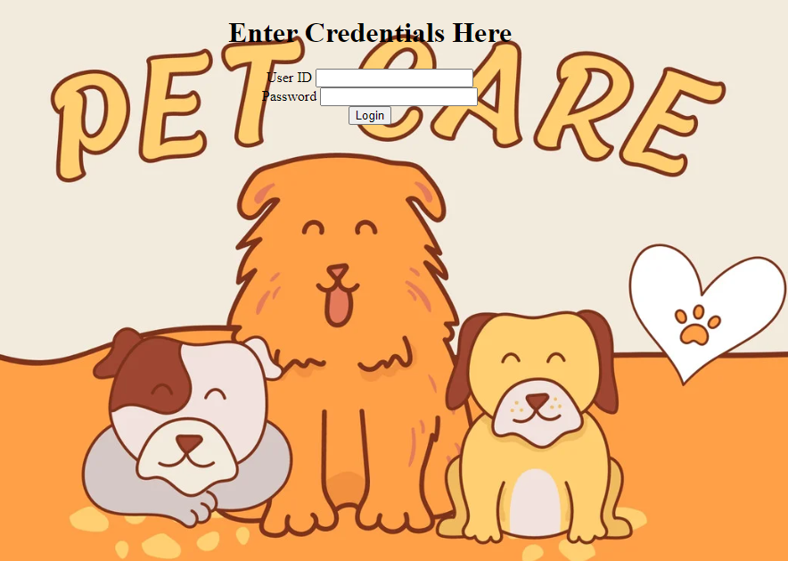
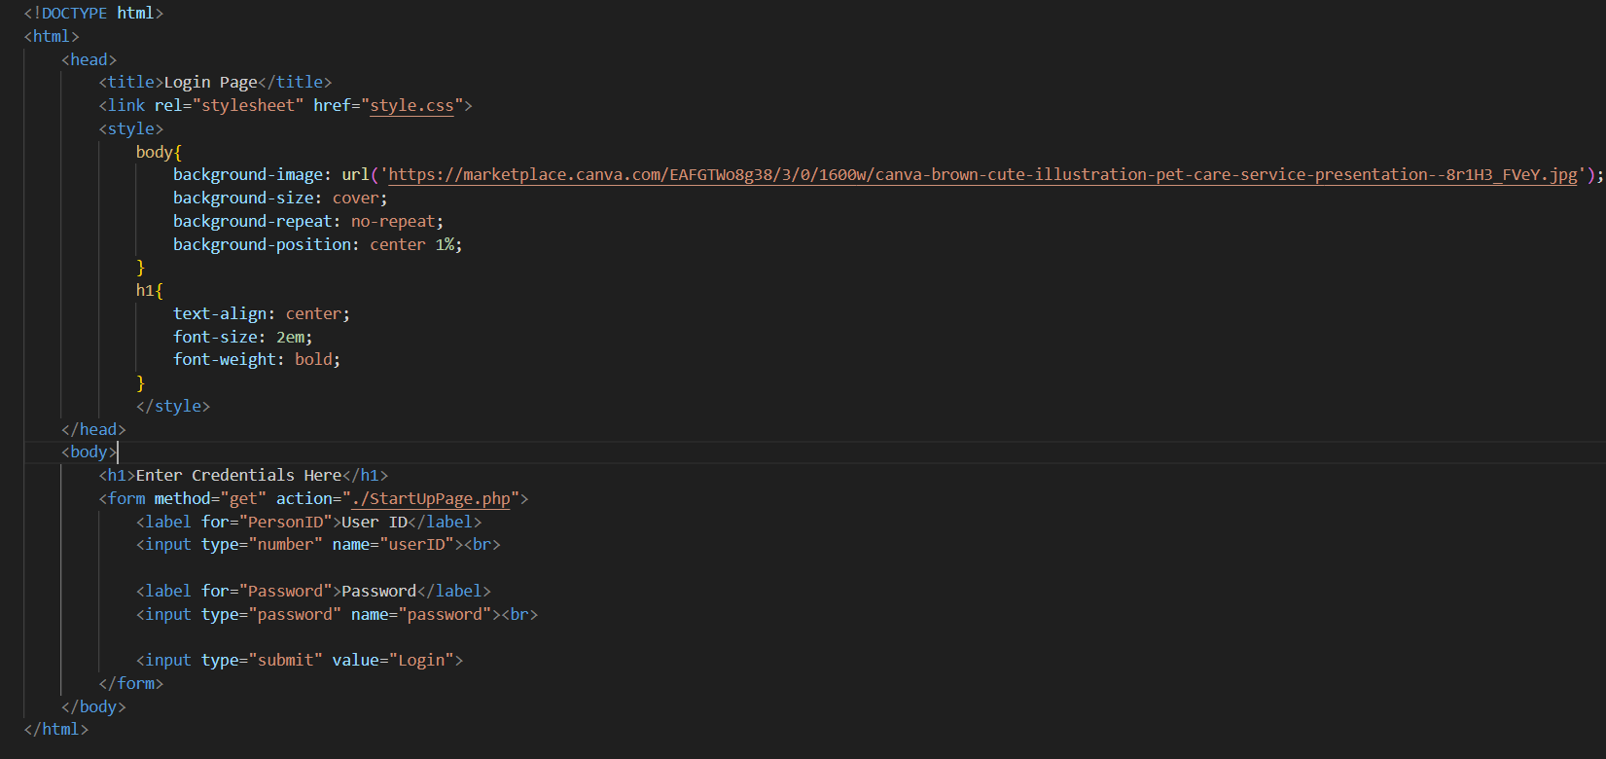
HTML Form, Client-side Web-based
This code represents the client-side part of a web-based architecture. An HTML form that collects user input for a User ID and Password uses the GET method to send this data to the server-side ( StartUpPage.php) page when the Login button is clicked.

Slide 12
Thank you! That’s All Folks

